Slide 1
B.Sc.- III
CHAPTER- SPECTROSCOPY
TOPIC : WIDTH OF SPECTRAL LINES
By:
SEEMA SAINI
ASSOCIATE PROFESSOR
GOVERNMENT COLLEGE, ROPAR

Slide 2
In molecular spectroscopy , the spectral lines depend on two factors : i) Width of the spectral lines decides the sharpness or broadness of the line ii) Intensity of the spectral lines decides the strength of the signal

Slide 3
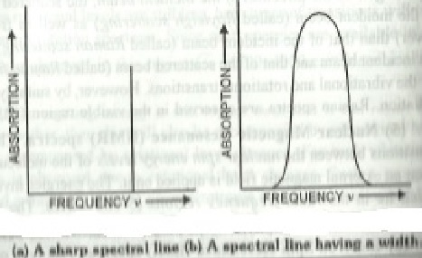
A) Width of the spectral line
If the spectral line is sharp, it will have no width i.e. it can be seen at a specific frequency only.
If the spectral line is broad, it will have a certain width i.e. It is spread over a range of frequencies.

Slide 4
Generally the spectral lines observed are broad. The width or broadening depends i) on the change in the absorbed or emitted frequency of the radiation (DOPPLER BROADENING) ii) time spent by the atoms ions or molecules in an energy state ( LIFETIME BROADENING) iii) upon natural lifetime limit (NATURAL LIFETIME BROADENING)

Slide 5
DOPPLER BROADENING
It is named after an Austrian physicist
Christian Doppler, who proposed it in 1842 in Prague.
The Doppler effect (or Doppler shift) is the change in frequency of absorbed or emitted radiation when the source is moving towards or away from the observer.
It is observed in case of gaseous samples as the molecules of the gases are in a state of continuous random motion.

Slide 6
If the source emitting the radiation is moving away from the observer or the observing instrument with a velocity ‘v’ , then the observer or instrument detects the radiation of frequency f’ f’ = f/1+ v/c where f’ is frequency of radiation detected by the observer f is the frequency emitted by the source v is the velocity of the radiation and c is velocity of light
If the source emitting the radiation is moving away from the observer or the observing instrument , then the observer or instrument detects the radiation of frequency f’

Slide 7
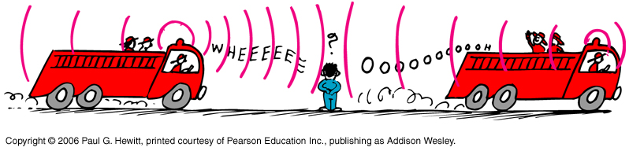
f’ = f/1- v/c
The difference f-f’ = δf is called Doppler shift or broadening
For example:

Slide 8
When the source of the waves is moving toward the observer, each successive wave crest is emitted from a position closer to the observer than the previous wave. Therefore, each wave takes slightly less time to reach the observer than the previous wave. Hence, the time between the arrival of successive wave crests at the observer is reduced, causing an increase in the frequency. While they are travelling, the distance between successive wave fronts is reduced, so the waves "bunch together“.
Conversely, if the source of waves is moving away from the observer, each wave is emitted from a position farther from the observer than "spread out".

Slide 9
the previous wave, so the arrival time between successive waves is increased, reducing the frequency. The distance between successive wave fronts is then increased, so the waves.
As the gas molecules are moving in different directions with different speeds, some towards and some away from the observer, so the spectral lines arise from all the resulting DOPPLER SHIFTS.
The shape of Doppler shift resembles that of Maxwells distribution of speeds as at a particular temperature the speed of the gas molecules is given by Maxwells distribution.

Slide 10
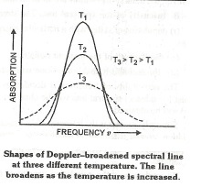
The width of the spectral line at half the height has also be deduced from the following relation δf = 2 f/c(2 kT ln2/m)⅟₂
Doppler Broadening increases with temperature as molecular speed increases with rise in temperature.
So in order to get maximum sharpness of the spectra, it is essential to work at low temperatures.

Slide 11
LIFETIME OR UNCERTAINITY BROADENING
Occurs in gaseous, liquid, solids as well as solutions.
This is due to quantum mechanical effects.
Particularly, if the quantum mechanical system (or the Schrodinger equation) is solved for a system that is changing with time it is impossible to specify the energy levels exactly.
If the system survives in a quantum state for a time ζ , the energy of the level in principle cannot be known with accuracy.

Slide 12
Then the energy levels are blurred to an extent δE , where
δE =h/2∏ζ
This term δE is called Uncertainty or lifetime broadening.
This is fundamental uncertainty relation for energy. In principle, no excited state has infinite lifetime, thus all excited states are subject of the lifetime broadening and the shorter the lifetimes of the states involved in a transition, the broader the corresponding spectral lines as
δE ∞ 1/ζ

Slide 13
Finite lifetimes of the excited states occur due to collision among the molecules or with the walls of the container.
If the mean lifetime between the collisions is ζcol, then the width of the line will be
δE = h/2∏ζcol = ħ/ζcol
In gaseous samples broadening can be minimized and collision lifetime increased by working at low pressures

Slide 14
NATURAL LIFETIME BROADENING
As every system in this universe is stable in a lower energy state, similarly all transitions from the excited states to lower states occur naturally or automatically . The rate of these transitions cannot be changed by changing the conditions.
This type of broadening which depends upon natural lifetime limit is called Natural line width of the transition. However these are so small that the other broadenings dominate.

Slide 15
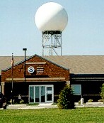
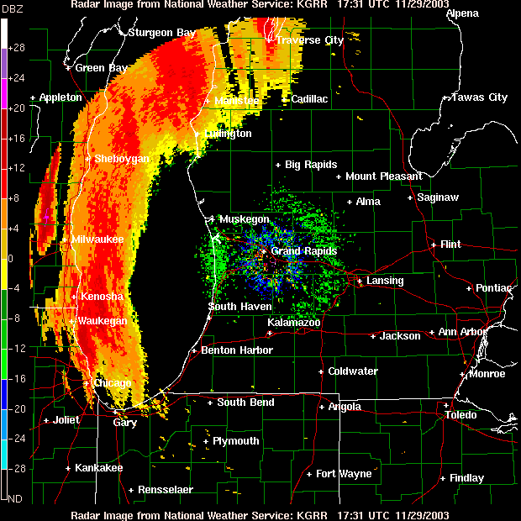
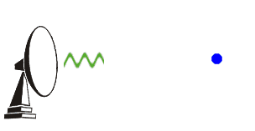
Applications: Weather Radar

Slide 16
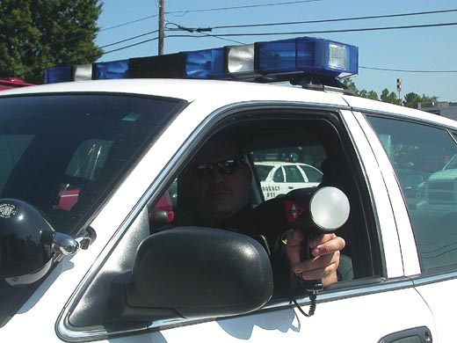

Speed Radar
Bounce radar waves off moving vehicles
Compares f of radar waves from gun with the f of reflected waves

Slide 17
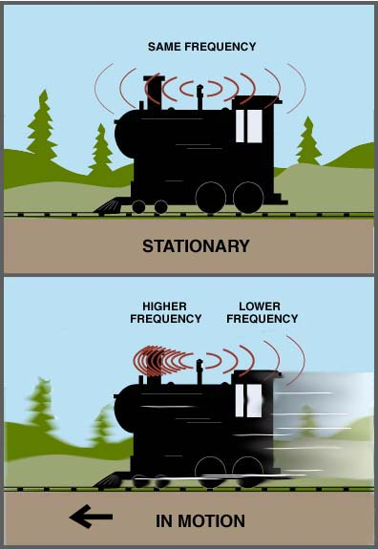
Doppler Effect : Moving Source
Water waves spread over flat surface, but Sound waves travel in 3-D and expand like balloon
What do you notice about the waves in front of train compared to those in back when train is stationary? In motion?
Wave crests ahead of moving source are closer together than behind source
What does this mean?
Higher frequency in front, lower frequency in back.
  i.e. car/train horn
  Demo with string and noise

Slide 18
THANK U

